Slide 1

22. März 2024
A07591000
Bosch Rodez
Assembly Solenoid Armature

Slide 2
Assembly Solenoid Armature
Contact
contact person at Gluth:
Harald Waas
Projektierung / project planning
Tel: +49 9421 544-918
Mobile: +49 160 98 363 373
Mail: harald.waas@gluth.de
contact person at BOSCH:
William Bauguil
Manufacturing sector (RzP/MFE1)
Tel: +33 5 6567-9485 |
Mobile +33 6 3426-4481 |
Mail: William.Bauguil@fr.bosch.com

Slide 3
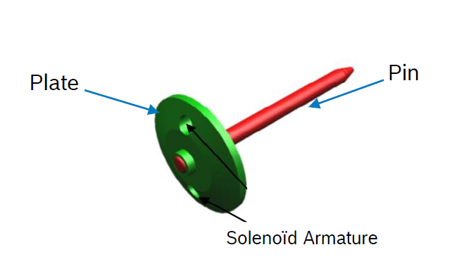
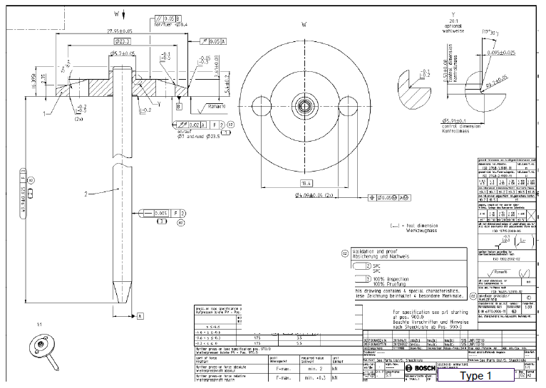
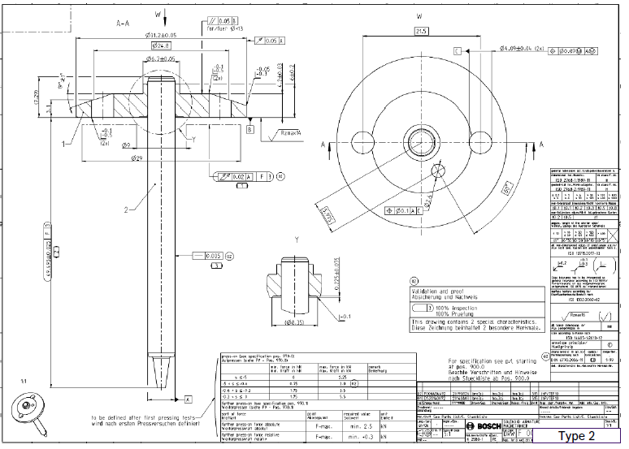
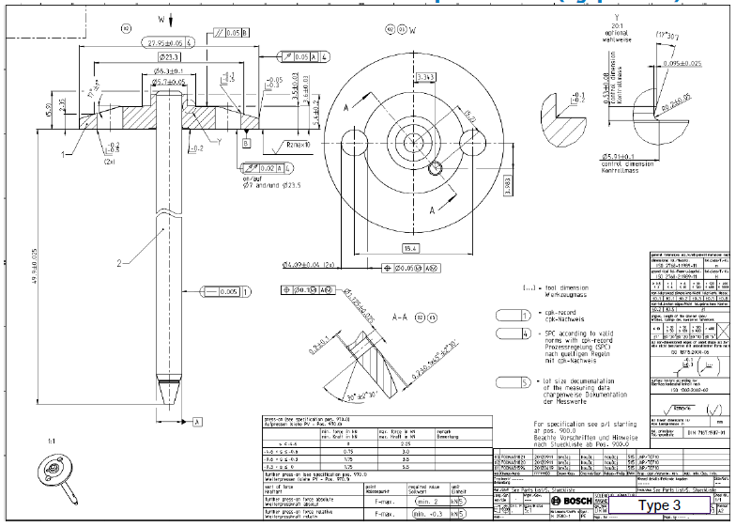
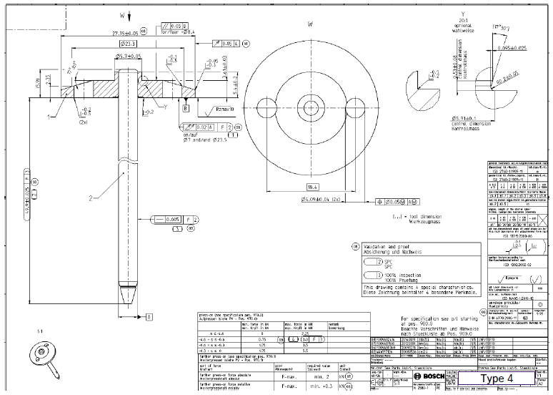
Assembly Solenoid Armature
Components
Cycle time: 8,2 sec.
Type 1
Type 2
Type 3
Type 4
5 kN
±0,025
1
Feed pin
(tray 300 pcs.
200x400mm)
2
Feed plate
(bulk - bowl feeder
capacity 300 pcs.)
6
Press
(Kistler press)
7
Check
(Heidenhain gauge)

Slide 4
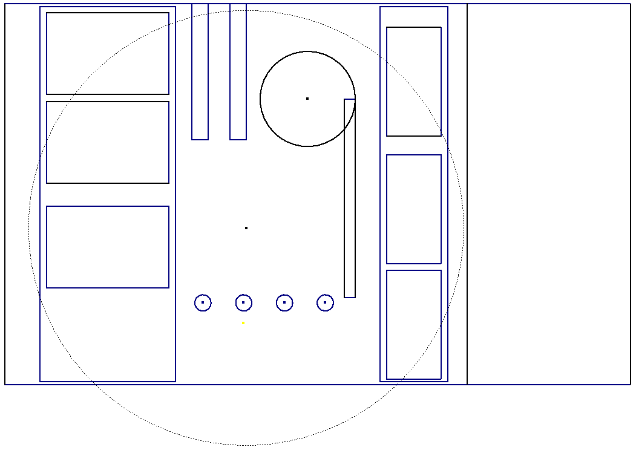
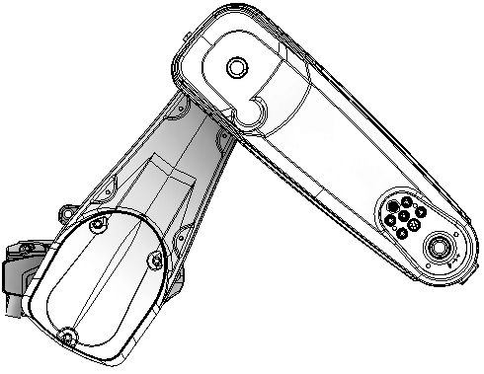
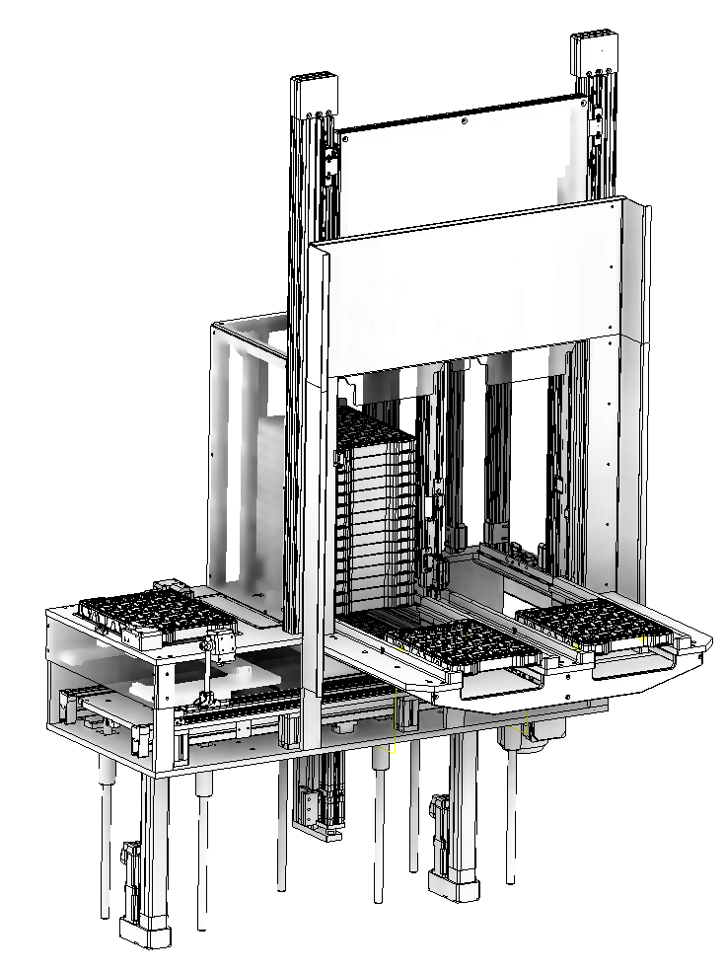


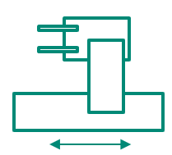
Assembly Solenoid Armature
Layout
Plate
Bulk - bowl feeder
capacity min. 300 pcs.
Pin
Tray 200x400
capacity 300 pcs.
1
Feeder Pin
Convoyer forTray 200x400
capacity 300 pcs.
Feeder Plate
bowl feeder
capacity min. 300 pcs.
Handling Plate
Pneumatic axis and gripper
Vibration rail to Kistler press
Handling Pin / Solenoid Armature
Pneumatic pilgrim step hanlding with 3 grippers
Robot handling Pin / Solenoid Armature
Staubli TS2-80 with single pneumatic gripper
Press
Kistler press max. 10kN
Check
Heidenhain gauge
Palletizer assembled parts
Palletizer with 2x6 trays
NIO parts
Drawer with 10 parts
SPC parts
Drawer with 10 parts
2
2
1
11
10
3
Palletizer assembled parts
Tray 300x450
capacity 50 pcs.
Palletizer with 2x6 trays
6x full / 6x empty
8
6x loaded
4
loaded
5
6x empty
6
5
processing tray
1400
7
processing tray
8
4
3
10
7
6
empty
11
Check
Press
2400
Cycle time: 8,2 sec.

Slide 5
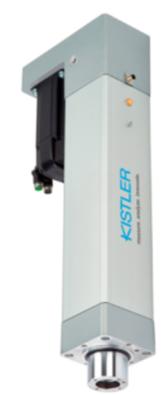
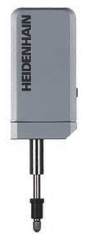
Assembly Solenoid Armature
Assembly concept
F = max. 5,5kN
v = 100 ±50 mm/min
Pressing time max. 4 sec.
from bowl feeder (handling)
bowl feeder capacity min. 300 pcs.
into tray (robot)
tray 50 pcs. 300x450mm
from tray (robot)
tray 300 pcs. 200x400mm
±0,025
±0,025
7
Check
(Heidenhain gauge)
6
Press
(Kistler press)
Cycle time: 8,2 sec.

Slide 6
Danke
für die Aufmerksamkeit

